Slide 1
Intel Unnati Industrial Training Program 2024 Report
Intel Unnati Internship Report by NIKITA CHAKRADHAR ZADE
III Year, B.Tech Artificial Intelligence and Data Science,
Faculty of Engineering and Technology, DMIHER (DU),
Sawangi (m), Wardha, Maharashtra
Mentor- MS. SHITAL HAJARE

Slide 2
Problem Statement
The problem statement assigned to me was based on “Introduction to Gen AI and Simple LLM Inference on CPU and finetuning of LLM Model to create a Custom Chatbot”, were I was able to built a chatbot on Intel Dev Cloud and also Fine tuned it.
My project addressed:
Implementing simple LLM inference on CPU
Fine-tuning an LLM model to create a custom chatbot
Overcoming the challenges of working with large pre-trained models
Applying my understanding of Python & Machine Learning to Gen AI

Slide 3
Unique Idea Brief
To address these challenges, I developed a hands-on approach that allowed me to gain practical experience.
Solution involved:
Investigating Gen AI ideas and LLM designs in great detail.
LLM inference implementation on CPU
Following a methodical procedure for optimizing pretrained LLMs
Using Intel AI Tools to create a personalized Chatbot.

Slide 4
Features Offered
Throughout my project, I successfully implemented the following features:
CPU-based LLM inference using optimized libraries
Fine-tuning of a pre-trained LLM for my specific use case
A custom chatbot capable of answering queries about Intel products along with the required datasets.
Performance optimization techniques to improve inference speed on CPU
A simple web interface for interacting with my chatbot
These features collectively demonstrated my ability to apply GenAI concepts in a practical, real-world scenario.

Slide 5
Process flow
I followed a systematic process to complete my project:
I began by deeply studying Gen AI concepts and LLM architectures, and its applications.
Next, I set up my development environment in Intel Cloud , installing necessary libraries and configuring Intel AI Tools on my system.
Then implemented LLM inference on CPU, optimizing it for better performance using techniques I learned from Intel's documentation.
Using the fine-tuned model, I developed a custom chatbot capable of answering queries about Intel products by giving max 5 input queries.
At Last , tested the chatbot, identifying and fixing issues, and further optimizing its performance.

Slide 6
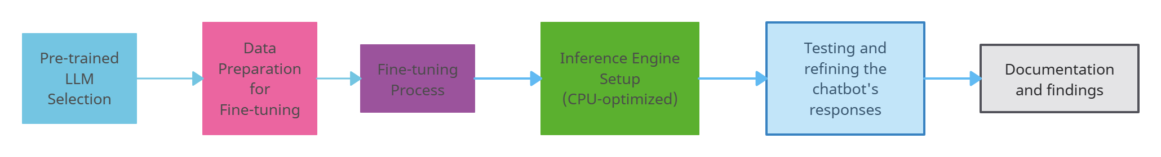
Architecture Diagram
Fig. Architecture Diagram for LLMs
This architecture illustrates the end-to-end process of developing a custom chatbot using fine-tuned LLMs.

Slide 7
Technologies used
In my project, I utilized the following technologies:
Python for all programming tasks
Hugging Face Transformers
TensorFlow for model training and inference
Intel® Distribution of OpenVINO™ toolkit for CPU optimization
Jupyter Notebooks for experimentation and documentation
This tech stack allowed me to efficiently develop and optimize my GenAI application.

Slide 8
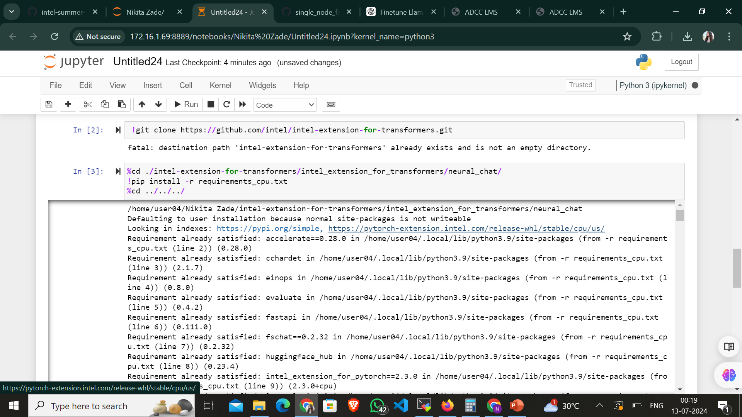
LLM Inferences in Action

Slide 9
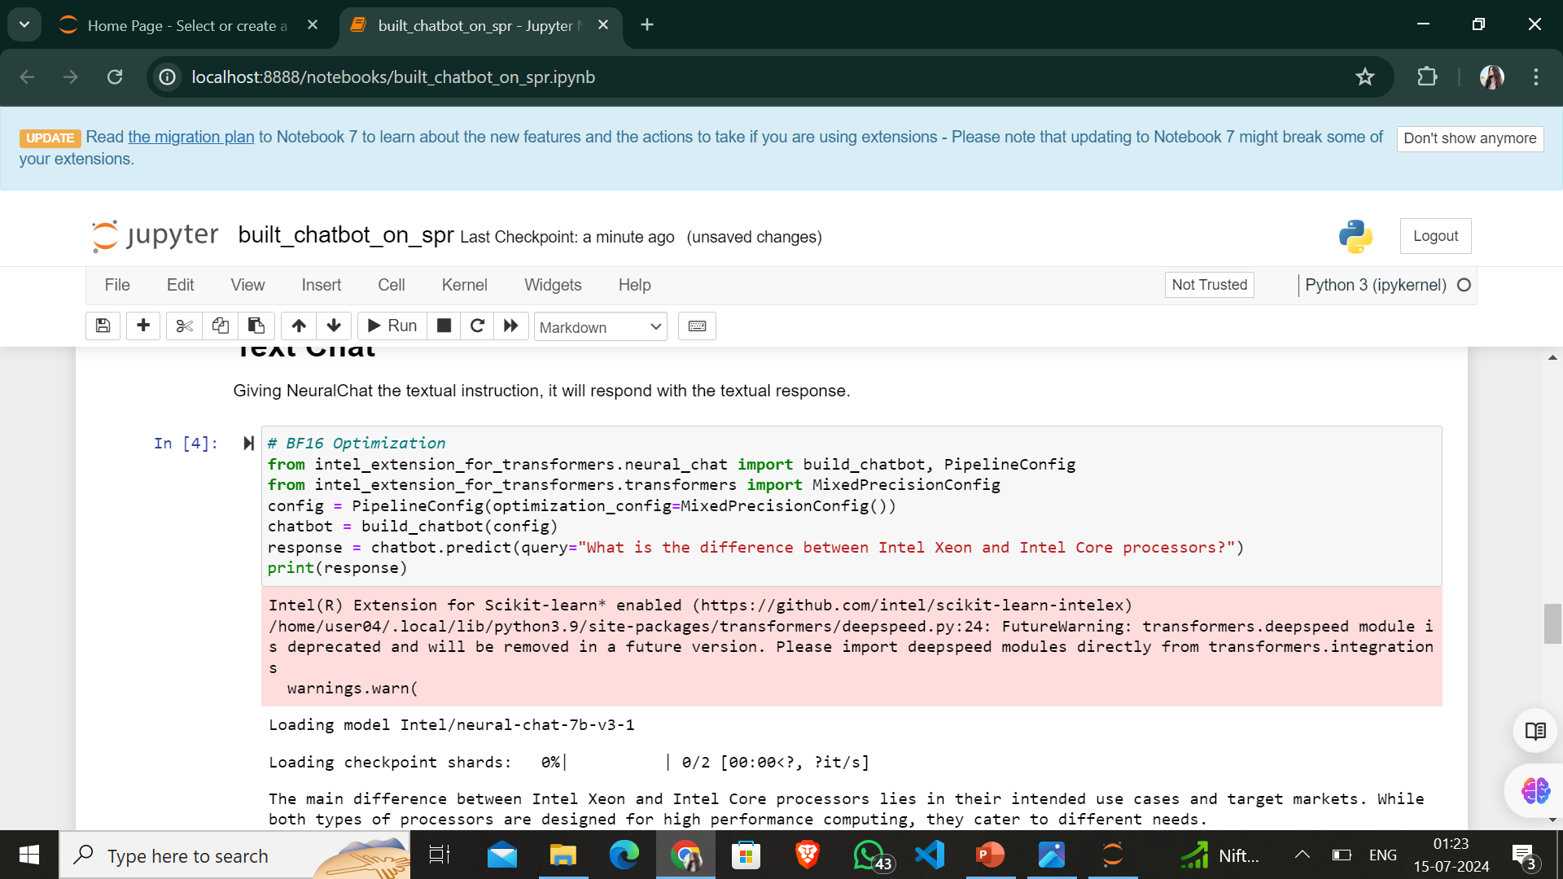
LLM Inferences in Action

Slide 10
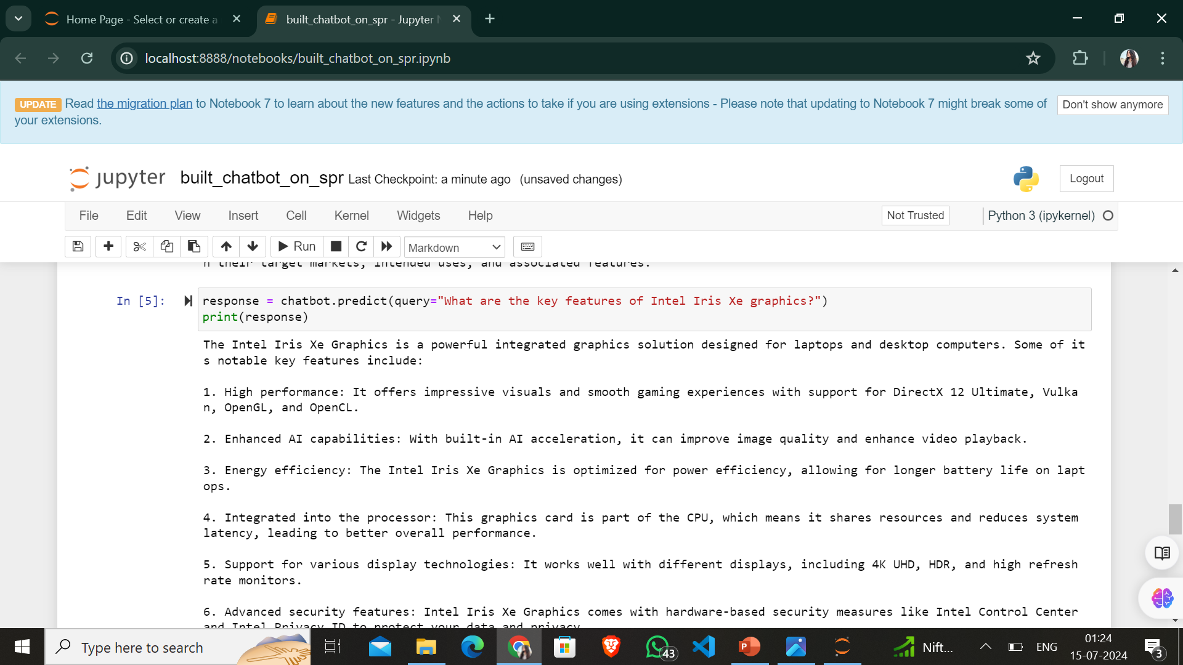
LLM Inferences in Action

Slide 11
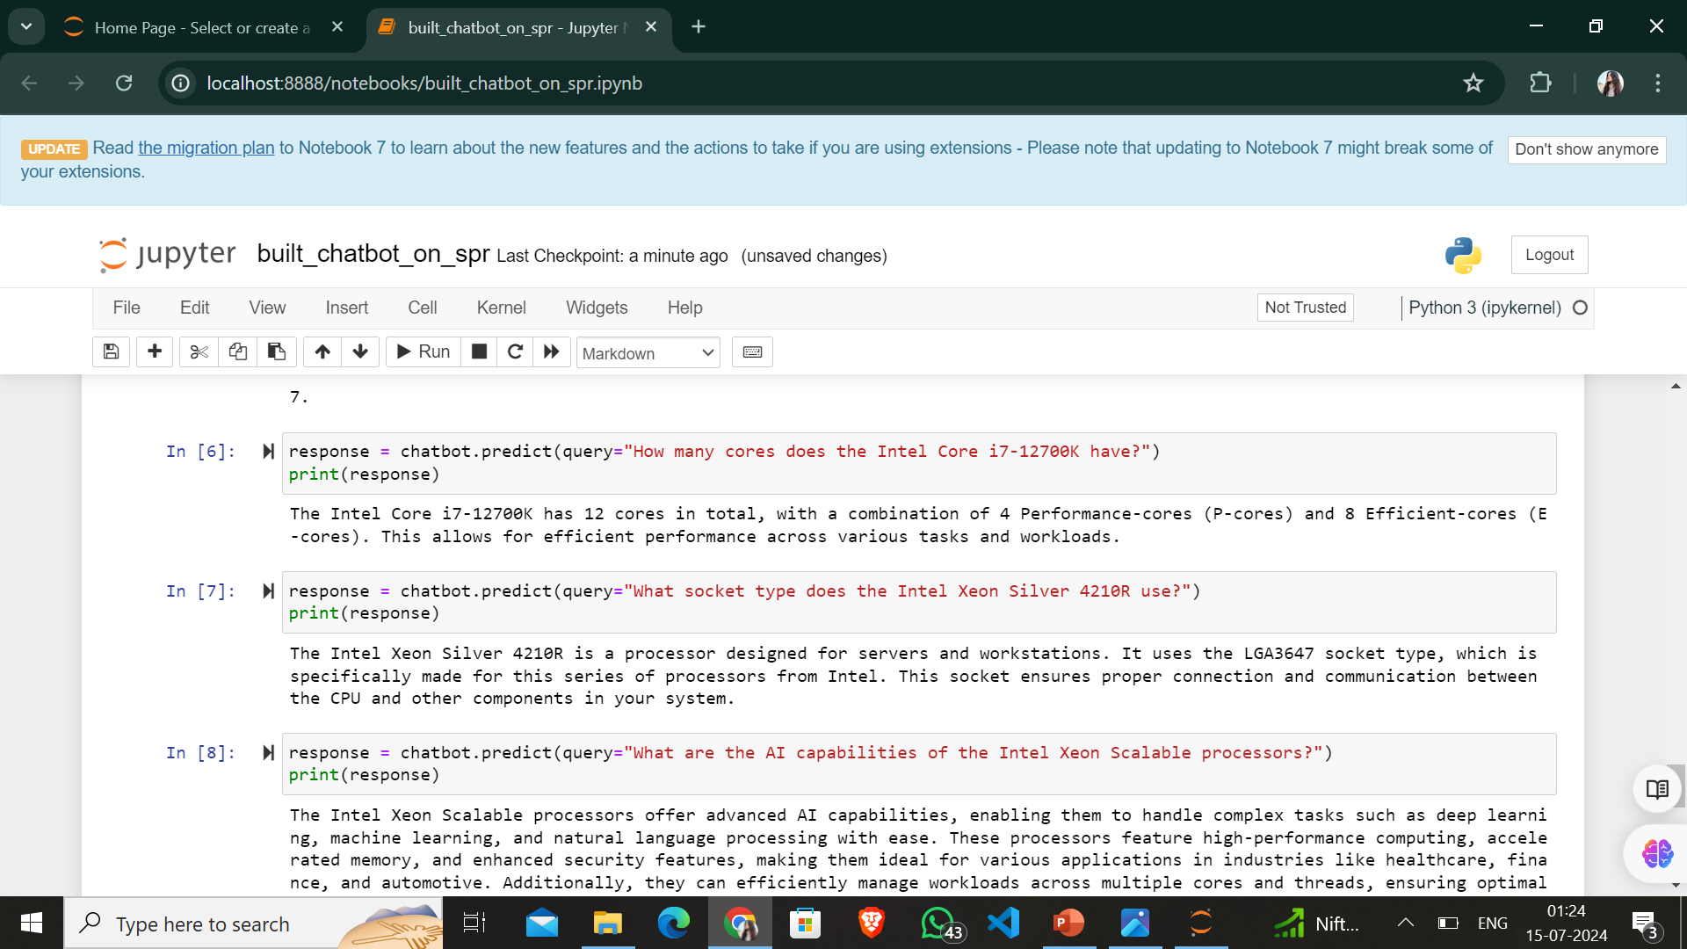
LLM Inferences in Action

Slide 12
Team members and Contribution
As an individual project, I was responsible for all aspects of development:
Researching Gen AI and LLM concepts
Implementing and optimizing LLM inference on CPU
Testing and refining the chatbot's responses
Documenting my process and findings

Slide 13
Conclusion
Throughout this Project I was able to obtain vital practical experience in the fields of large language models and generative artificial intelligence through the Intel Unnati Industrial Training Program 2024. By overcoming the difficulty of using resource-intensive models on a CPU-only configuration, I was able to show that significant AI development is feasible even in the absence of specialist hardware.
Key achievements include:
Implementing efficient CPU-based LLM inference
Successfully fine-tuning chatbot
Gaining proficiency in using Intel AI Tools for optimized AI development

